Slide 1


Wet/Dry Cycling Design Defense
06.11.2025
By:
Rafael Delwart,
Matthew Randall,
Ryan Taylor,
Cole Schreiner,
Liz Villa

Slide 2
Project Introduction and Motivation
Theories of life’s origins traditionally focus on ocean hydrothermal vents, however recent research emphasizes freshwater hydrothermal pools (volcanic puddles) may be a more suitable location for the formation of life
These hydrothermal pools have characteristic dehydration and rehydration cycles hypothesized to be essential for RNA polymerization
Few systems exist to precisely replicate the environmental conditions of hydrothermal pools in a laboratory setting
The team successfully created a modular system to replicate the hydrothermal pool conditions to progress the origins of life research
The project was motivated by a need to advance experimental capabilities in origins-of-life research through a system that automates temperature control, fluid handling, gas regulation, and mixing
Notes:
Transition: In order to realize the project, the team first needed to understand the project client and their related research.

Slide 3
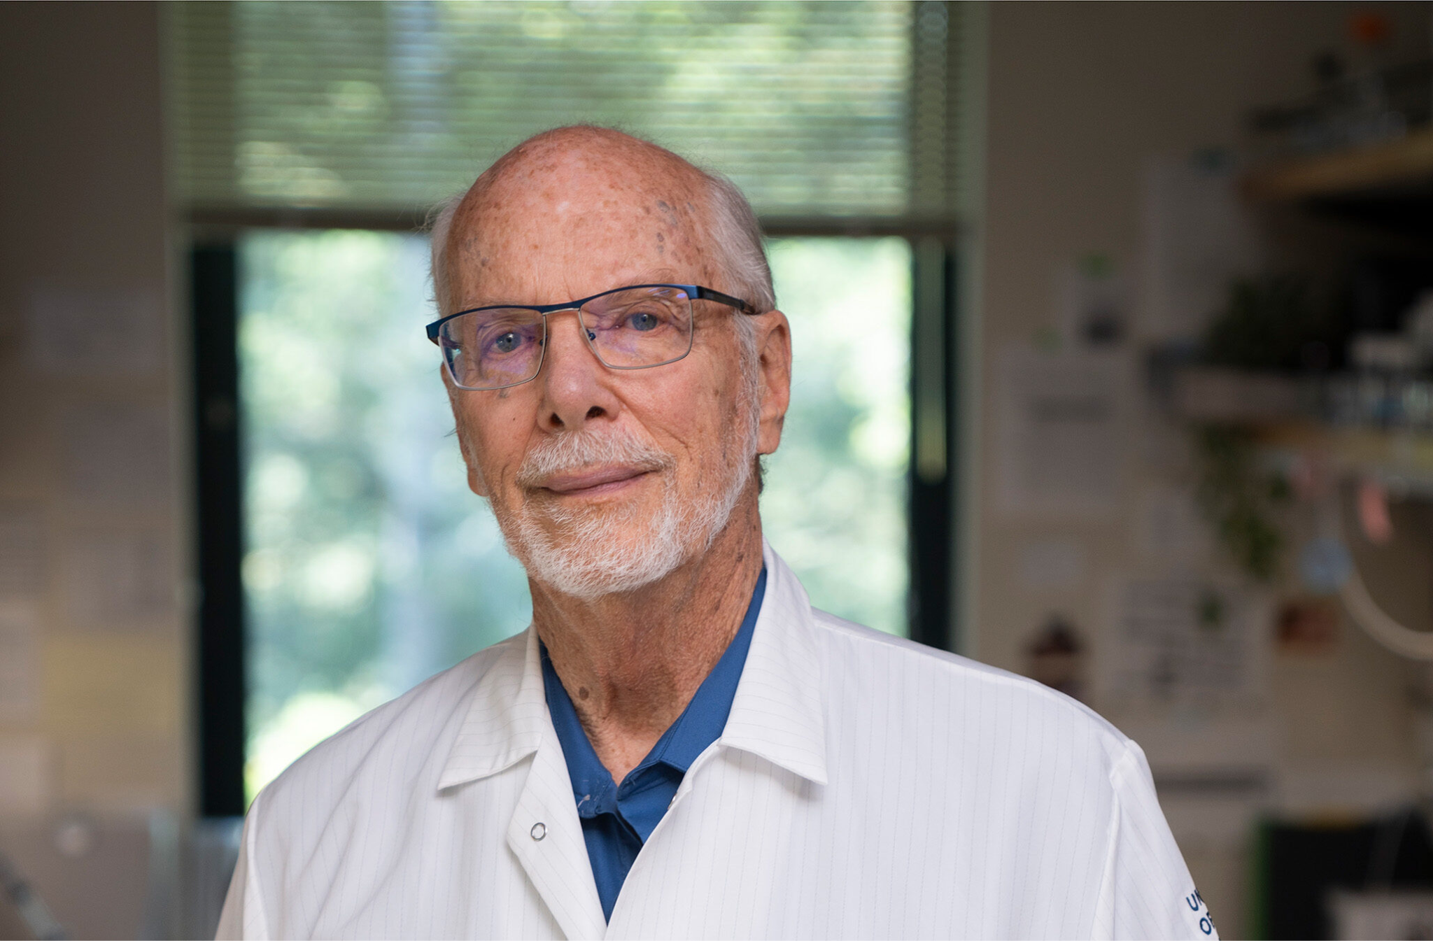
Project Stakeholder: Professor David Deamer
Client: Professor David Deamer
David Deamer is a Professor of Biomolecular Engineering at UC Santa Cruz whose work focuses on the origins of life
His current research explores how RNA polymers form with wet-dry cycles in environments such as volcanic puddles.
Salt-promoted synthesis of RNA
HotSpringHypothesis-Astrobiology 2020
Visualizing RNA polymers produced by hot wet-dry cycling
Notes:
Transition: Given the client, to realize the objectives for this project, we needed a team of engineers. Their roles are described in the system level block diagram which is used to describe the project from a system level perspective

Slide 4
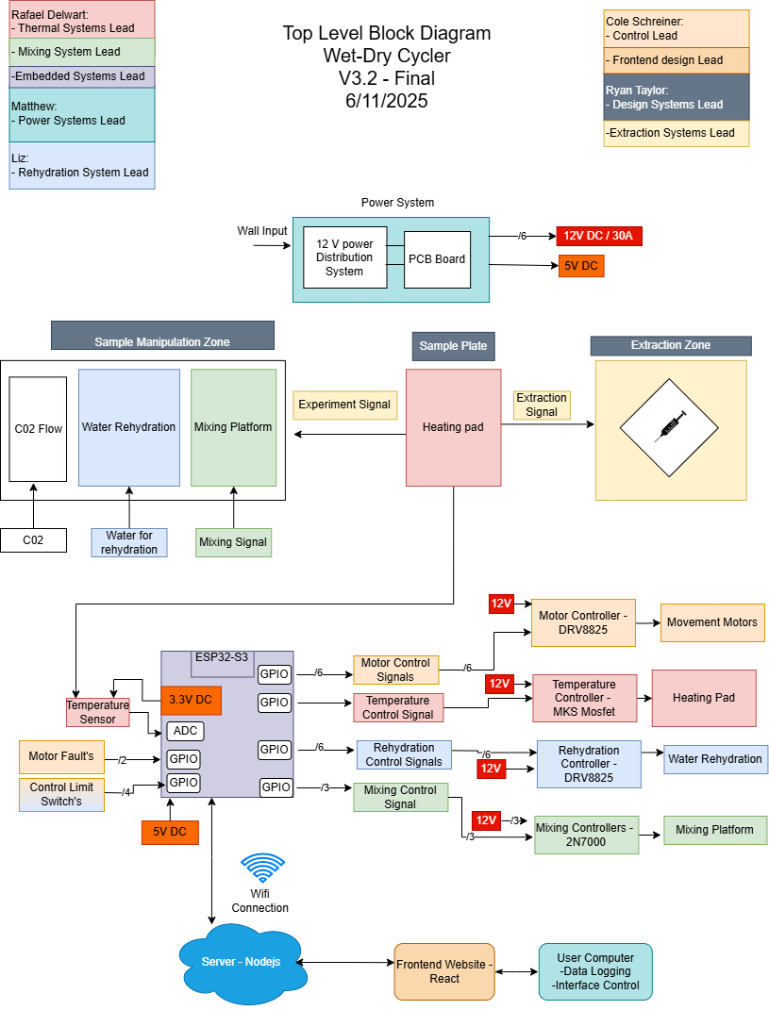
Overall System Block Diagram
Block Diagram

Slide 5
Deliverables
Accommodate 10 to 12 samples within the system
The samples must be housed in removable glass containers for intra-experimental analysis
Control a periodic flow of water into the reaction mixture. Sample’s wet cycle volume should be approximately 0.1 mL (100 µL) ±13%
Incorporate stirring capabilities to agitate samples for 1–2 minutes following each rehydration cycle
Maintain a constant temperature of 90°C (±5ºC) under the sample vials
Implement a regulated flow of carbon dioxide or nitrogen gas over the sample

Slide 6
Standards Employed for Engineering Design
Standards Followed:
Technical Documentation Standards in Engineering Design - UCSC ECE Department (Petersen & Favaloro)
Electrical Standards:
Standards of Good Engineering Practice for PCB Design - S.C. Petersen
Introduction to Power Supplies (AN-556) — Ralph E. Locher, National Semiconductor
Embedded Standards
Embedded C Coding Standard - Michael Barr
Mechanical Standards:
Pipette Calibration - Texas Tech University
Dimensioning and Tolerancing (ANSI Y14.5-2009) – ANSI

Slide 7
Rehydration Subsystem Design
Deliverable:
Rehydrates 12 samples with 100uL of water with ±13 % precision
Approach:
Design a syringe pump that runs autonomously
Notes:
this is our current model of our syringe pump
this was decided after team meeting when we decided that the lead screw syringe pump would be best at its standard throughout most syringe pumps used in lab equipment
It uses the same mechanism as our movement system it is translating rotational motion into linear movement.

Slide 8
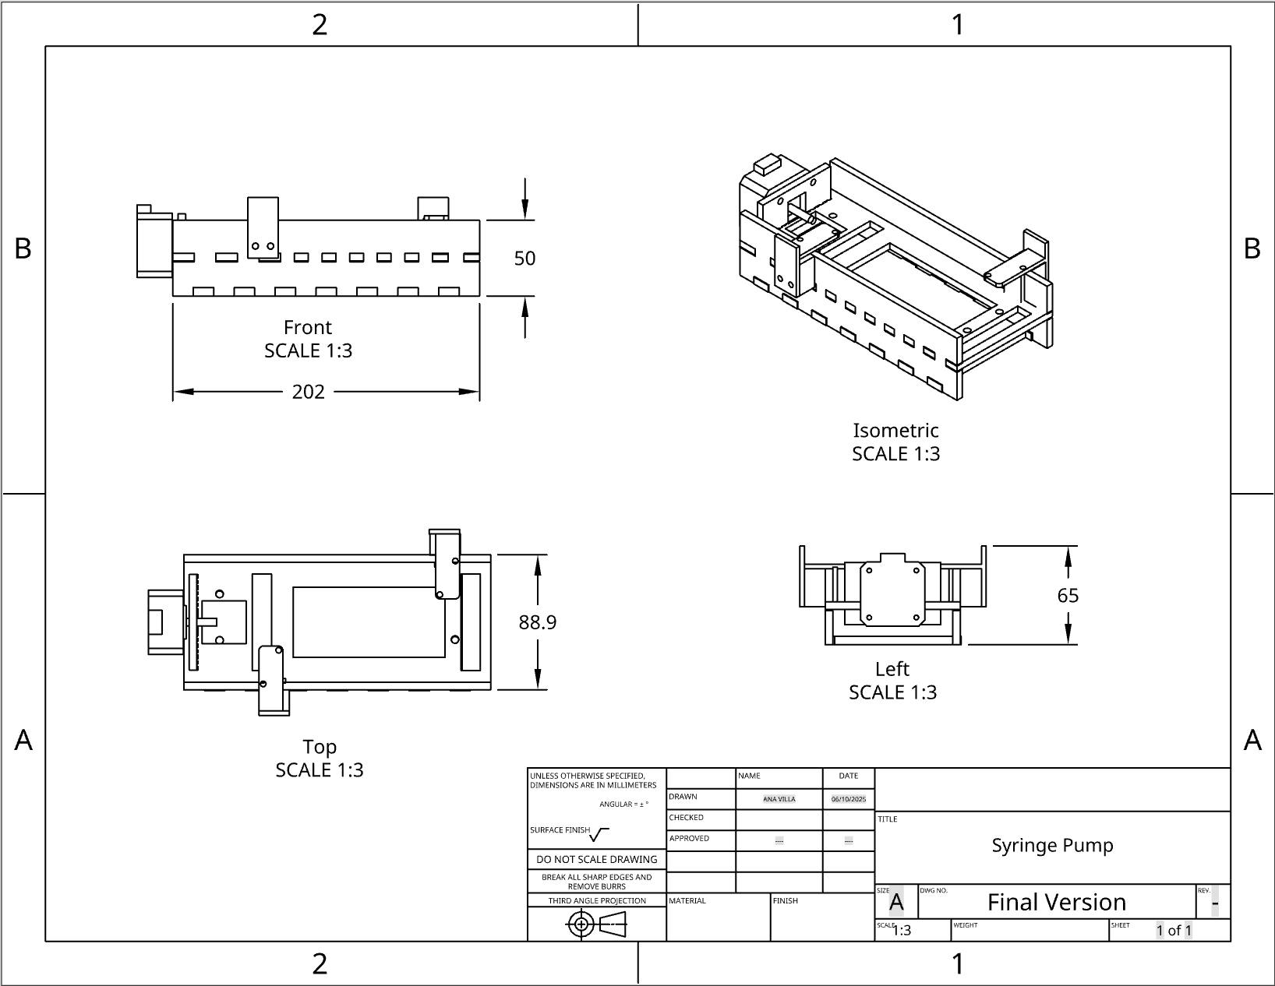
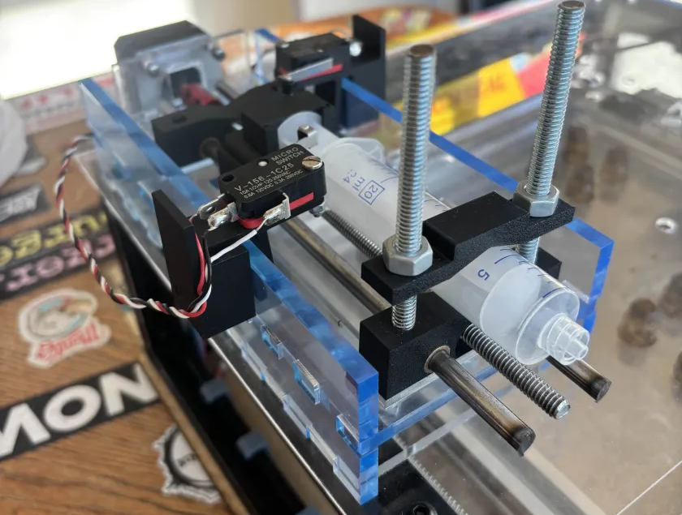
Syringe Pump Design-Final Version
Mechanical Design:
Uses threaded rod and stepper motor to control the amount of water pushed from the syringe
Calibration:
User enters the syringe inner diameter.
System calculates the number of motor steps needed to deliver a specific volume (µL)
Modular functions command the stepper motor to dispense the desired volume
Link to dimension drawing of syringe pump
Notes:
Lead screw syringe pumps excel at precise small-volume dispensing because their threaded mechanism converts motor rotation into ultra-precise linear plunger movement.
The design provides micrometer-level resolution for accurate 100 µL delivery, while resisting backpressure variations across multiple ports. Its inherent mechanical stability ensures repeatable results across tests, with minimal backlash or drift.
The direct-drive action prevents pulsing, crucial for bubble-free microfluidics.
This robust yet simple approach mirrors commercial systems, offering lab-grade performance in your DIY setup through precise motor control and reliable mechanical displacement.

Slide 9
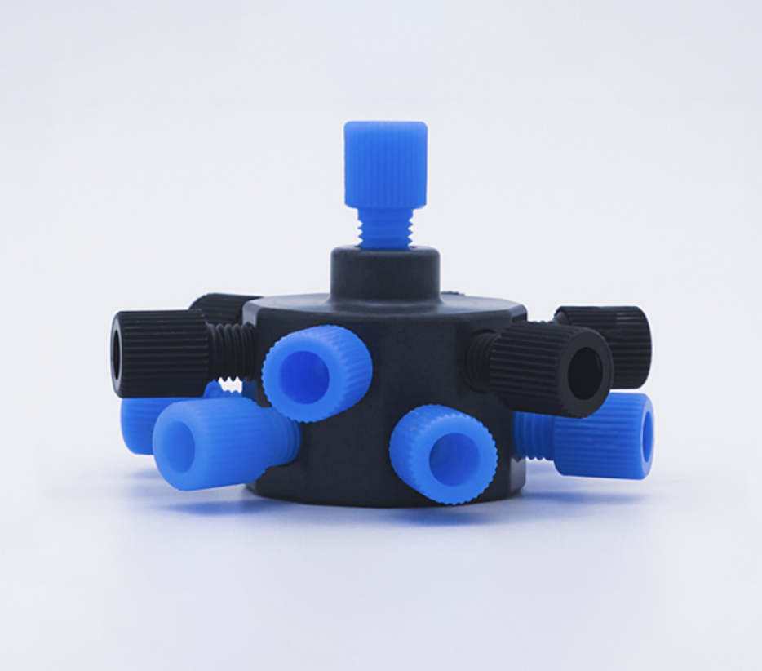
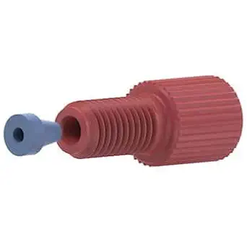
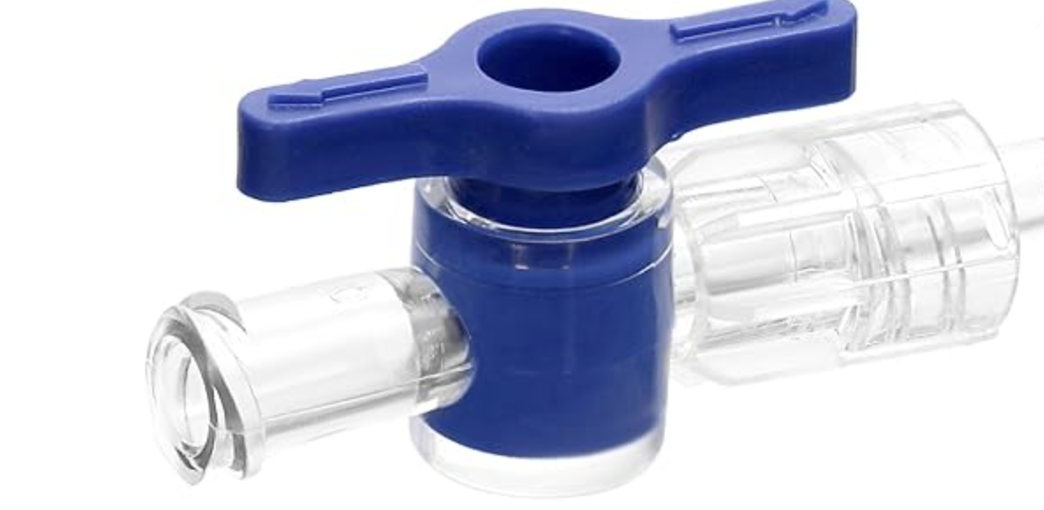
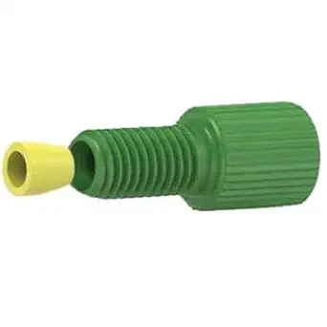
Materials used for Syringe Pump Design
Materials:
13 Port manifold
PTFE 1/16’’ OD tubing
Idex Flangeless Fitting, Standard Knurl, Red Acetal, 1/16’’ OD Tubing, 1/4-28 Flat-Bottom
Idex Flangeless Fitting, Standard Knurl, Green Acetal, ⅛’’ OD Tubing, 1/4-28 Flat-Bottom
2-Way Stopcocks with Luer Connection
Notes:
Flow Resistance & Equal Distribution
polytetrafluoroethylene
The 1/16" OD tubing provides sufficient hydraulic resistance to ensure equal flow splitting across all 12 outlets. Without this resistance, fluid would favor the path of least resistance, leading to uneven dispensing.
Poiseuille’s Law (ΔP ∝ 1/r⁴) means small changes in tubing ID significantly affect backpressure. The narrower outlet tubing balances pressure drops, ensuring each port gets ~100 µL
Resistance depends HUGELY on tube size—smaller tubes = way more resistance.
Specifically, resistance increases with the 4th power of the radius (r⁴).
If you halve the tube diameter, resistance increases 16×!
For small volumes (100 µL total, ), low-dispense systems require minimal dead volume (achieved with flangeless fittings) and laminar flow (ensured by small tubing).
Pascal's principle is defined as: A change in pressure at any point in an enclosed incompressible fluid at rest is transmitted equally and undiminished to all points in all directions throughout the fluid, and the force due to the pressure acts at right angles to the enclosing walls.
The 1/8" OD inlet allows adequate flow supply without excessive pressure buildup before splitting.
The inlet is wider (1/8") so liquid enters fast, but the narrow outlets (1/16") slow it down evenly.
Why PTFE?
Slippery inside → Less clogging.
Seals tightly → No leaks at fittings.
Bubble-proof → Critical for precision dispensing.
Why the latch to prevent drippage and help with syringe switching out
Preventing Cross-Port Backflow

Slide 10
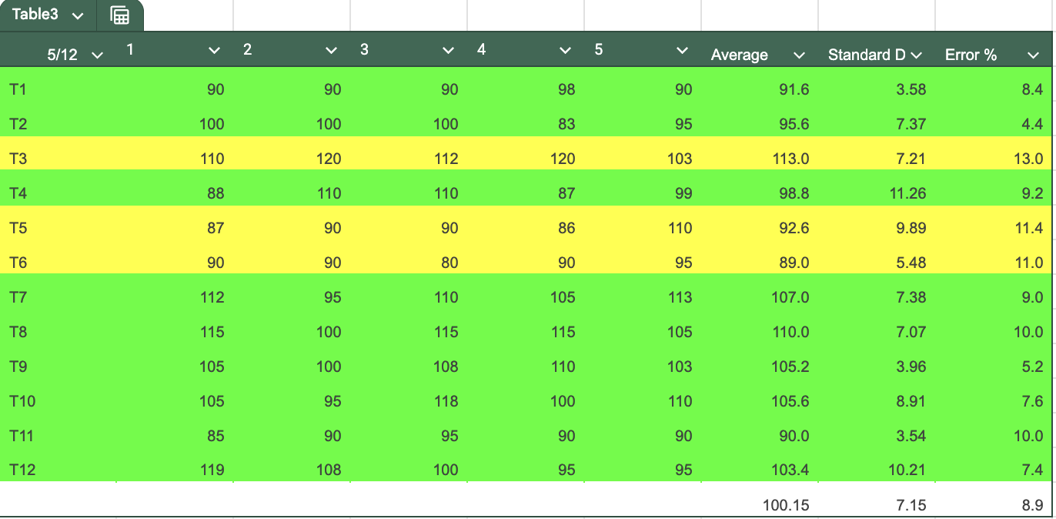
Syringe Pump Design Verification
Methods:
Pre-fill tubing to eliminate air bubbles before testing
Use calibrated pipettes (instead of expensive scales) to measure dispensed water volume per port
Record data for each port’s dispensed volume (~100 µL target)
Run 5 trials per port to ensure consistency
Adjust tubing based on results:
Over-dispensing → Add bends to increase resistance
Under-dispensing → Reduce bends to decrease resistance
Re-test after adjustments until all ports dispense ~100 µL ± acceptable error under 13%
Testing Data
Calibrating a Pipette
Notes:
Procedure (Bullet Points)
Dead space of about 600uL
Pre-fill tubing to eliminate air bubbles before testing.
Use calibrated pipettes (instead of expensive scales) to measure dispensed water volume per port.
Industry professionals recommended this as a cost-effective and reliable method.
Pipettes are pre-calibrated using high-precision scales, minimizing error.
Record data for each port’s dispensed volume (~100 µL target).
Run 5 trials per port to ensure consistency.
Adjust tubing based on results:
Over-dispensing? → Add bends to increase resistance.
Under-dispensing? → Reduce bends to decrease resistance.
Re-test after adjustments until all ports dispense ~100 µL ± acceptable error.
PTFE tubing holds bends well, preventing deformation over time.
Formatted Explanation
To verify that the syringe pump accurately dispenses 100 µL per port, I used a pipette-based measurement method recommended by industry professionals. Since high-precision scales are expensive, I relied on pre-calibrated pipettes, which are traceable to precise measurements, ensuring minimal error.
Before testing, I pre-filled the PTFE tubing to remove air bubbles, ensuring consistent flow. For each of the 12 ports, I collected the dispensed volume and recorded it over 5 trials to assess repeatability. If a port consistently over- or under-dispensed, I adjusted the tubing resistance by adding or reducing bends—since PTFE retains its shape, these modifications remained stable.
This iterative process allowed me to fine-tune the system until each port reliably delivered 100 µL ± a tolerable margin of error. By using pipettes instead of scales, I maintained accuracy while keeping costs low, aligning with standard lab practices for small-volume liquid handling.

Slide 11
Mixing Subsystem Design
Deliverable:
Incorporate stirring capabilities to agitate samples for 1–2 minutes following each rehydration cycle
Approach:
Mixing was achieved through a mixing platform consisting of three DC motors that agitate samples in the manipulation zone

Slide 12
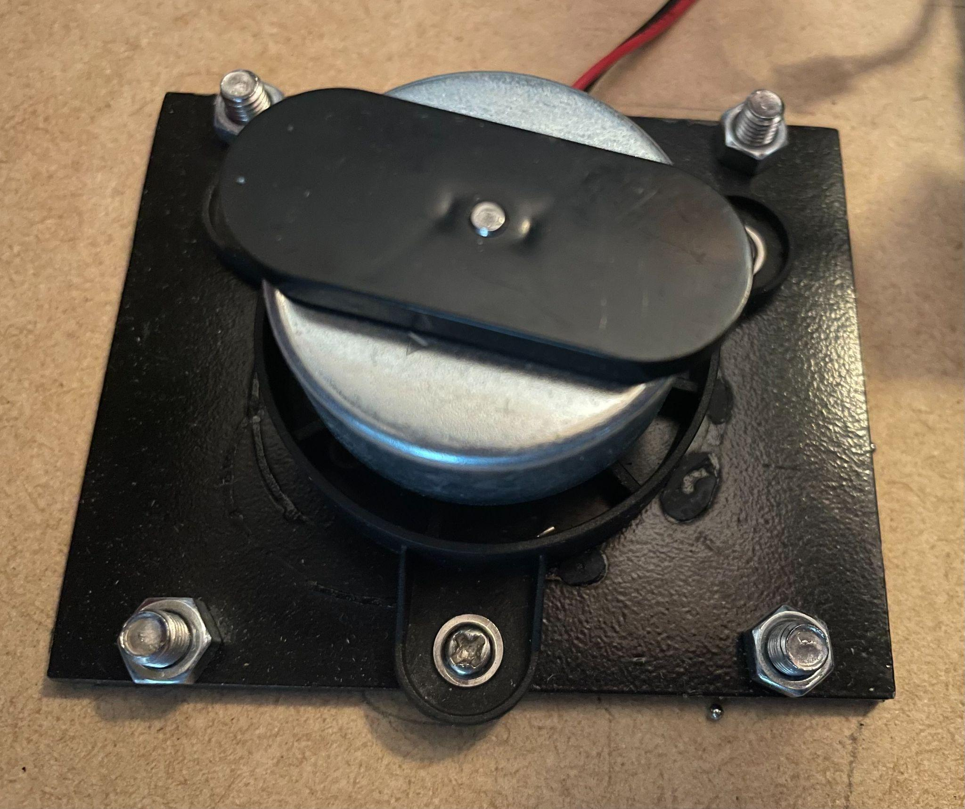
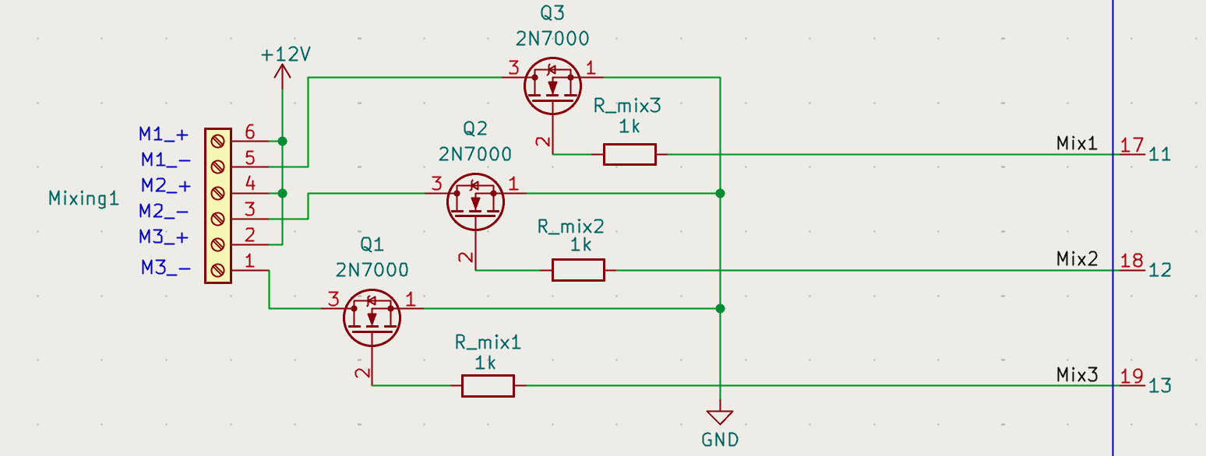
Magnetic Stir Bar Mixing Implementation
System Design:
Utilized magnetic stir bars spun by brushless DC motors with large magnets
A simple FET circuit allows the controller to turn motors on and off (circuit image link)
Notes:
Now that the sample has been rehydrated and mixed the sample needs to be dehydrated.

Slide 13
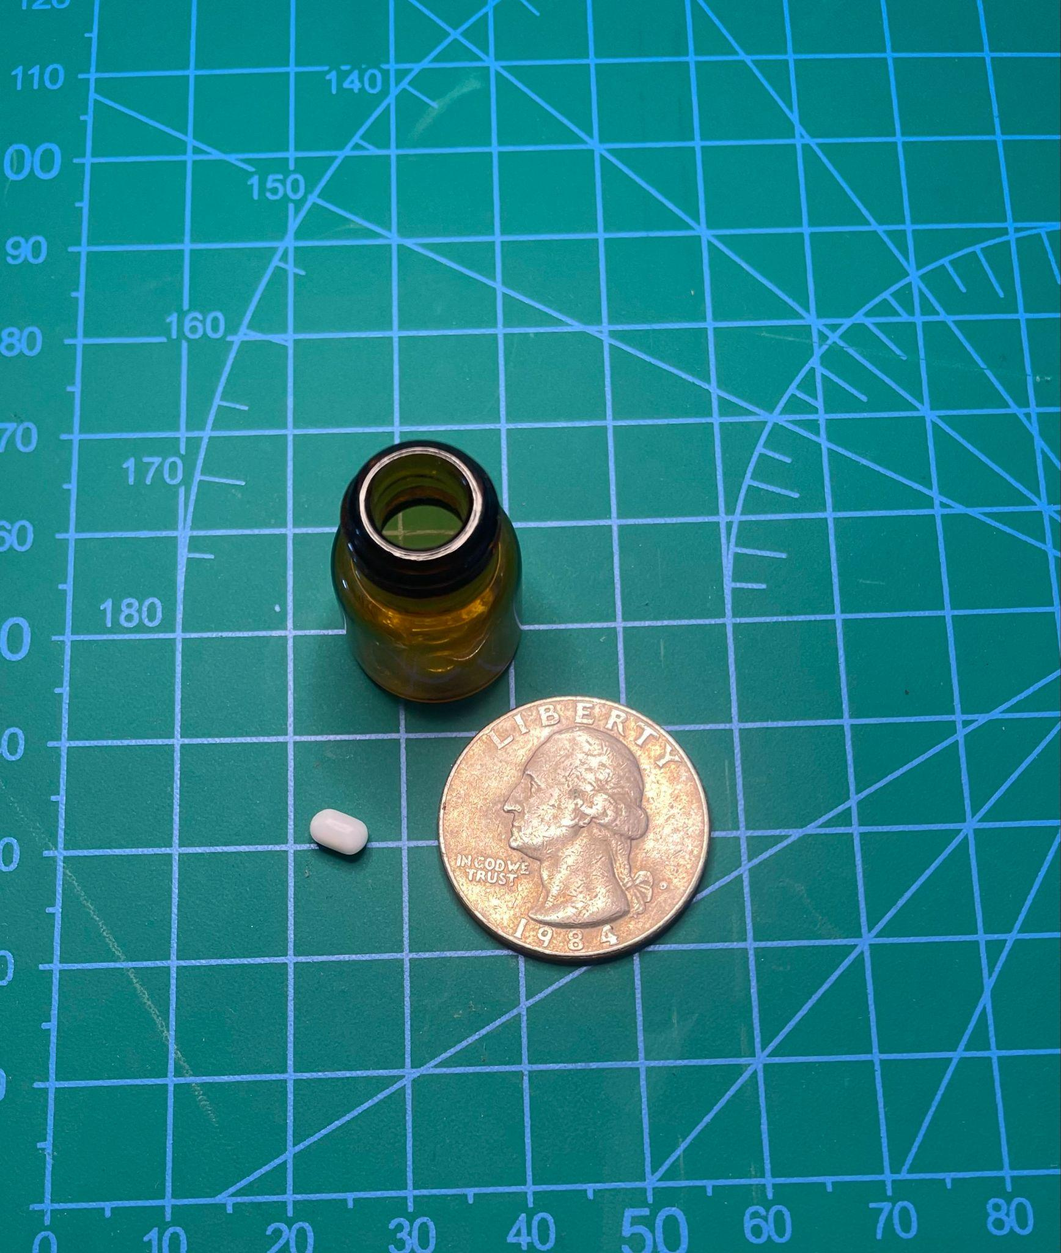
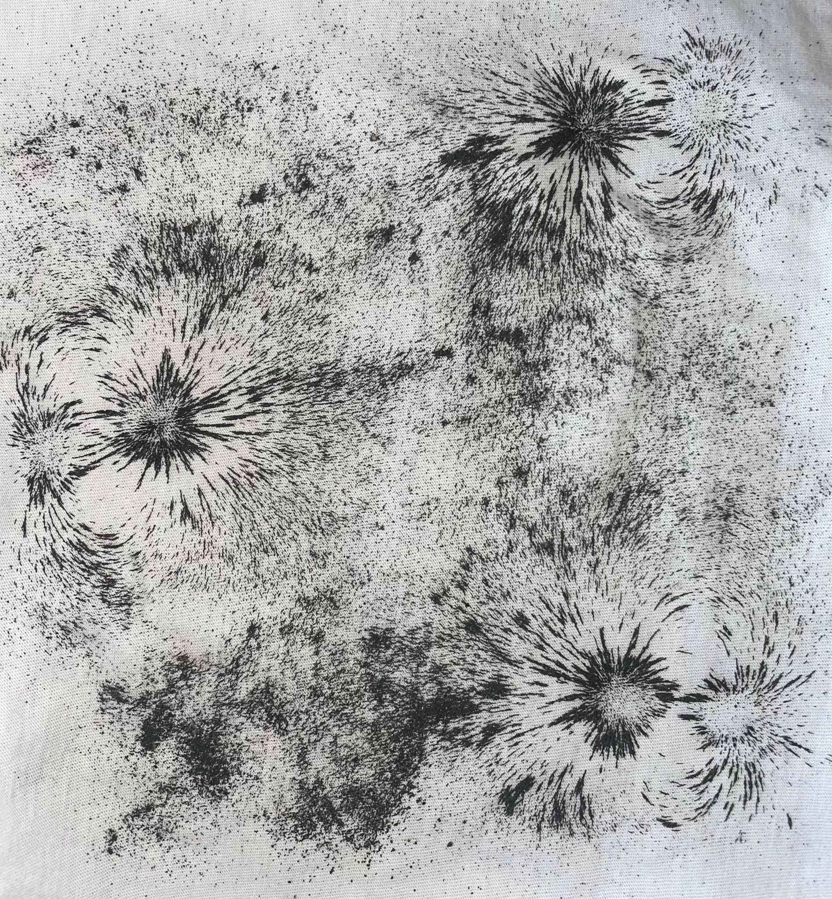
Mixing Arrangement and Testing
Motor Arrangement:
Three motors sit under each set of four vials for mixing
Enables independent mixing of different sample sets
Magnetic Interference:
Magnetic sand was used to ensure the magnetic fields do not interfere with the other sample zones
Notes:
Now that the sample has been rehydrated and mixed the sample needs to be dehydrated.

Slide 14
Heating Subsystem Design
Deliverable:
Maintain a constant temperature of 90°C (±5ºC) under the sample vials
Design Method:
Heating was achieved using a heating pad attached to the aluminum plate to dehydrate samples in the manipulation zone

Slide 15
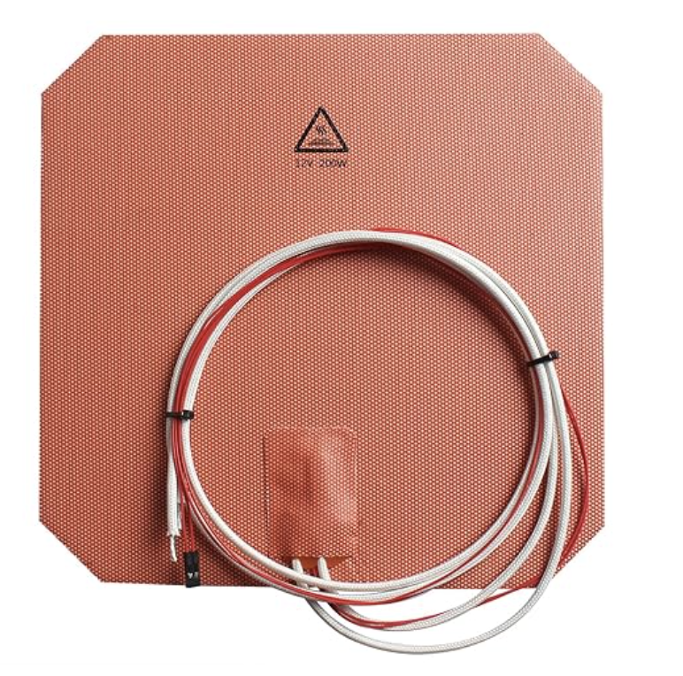
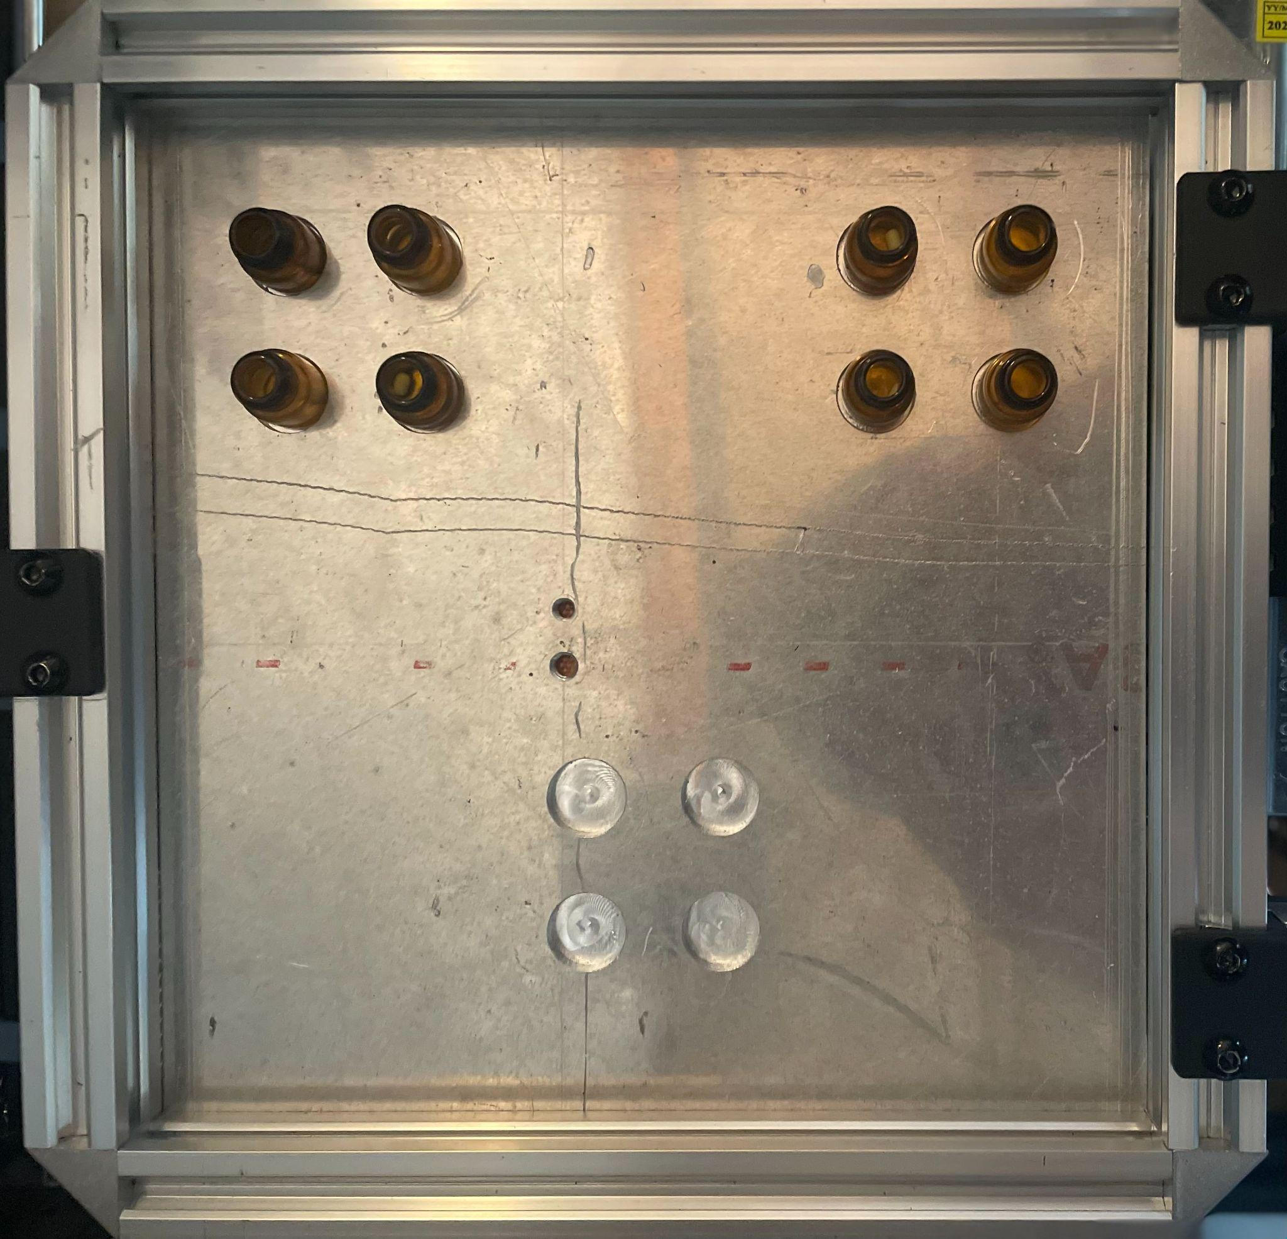
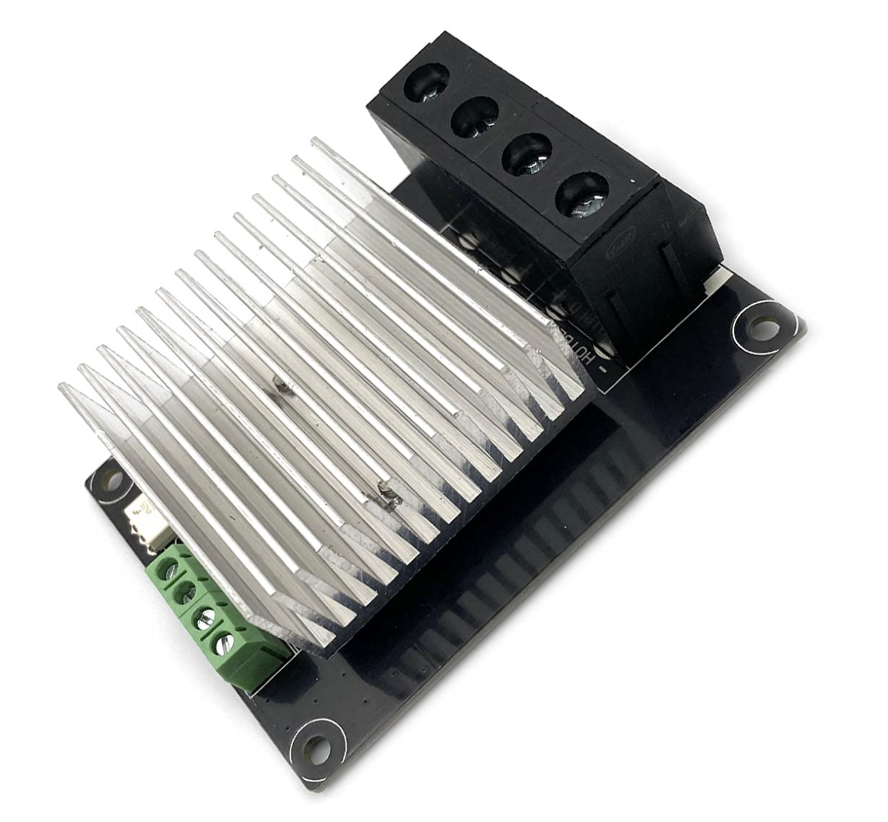
Silicon Pad Implementation
Silicon Heating Pad:
12V, 200W plate with a size of 218mm x 218mm
Built-in 100K NTC thermistor
Aluminum Plate:
Machined out of 2024 Aluminum
Silicone heat plate fixed using factory adhesive
Circuit Implementation:
A high current MOSFET controller switches 12V input on/off.
Notes:
To control the heating pad at a desired temperature bang-bang feedback was implemented

Slide 16
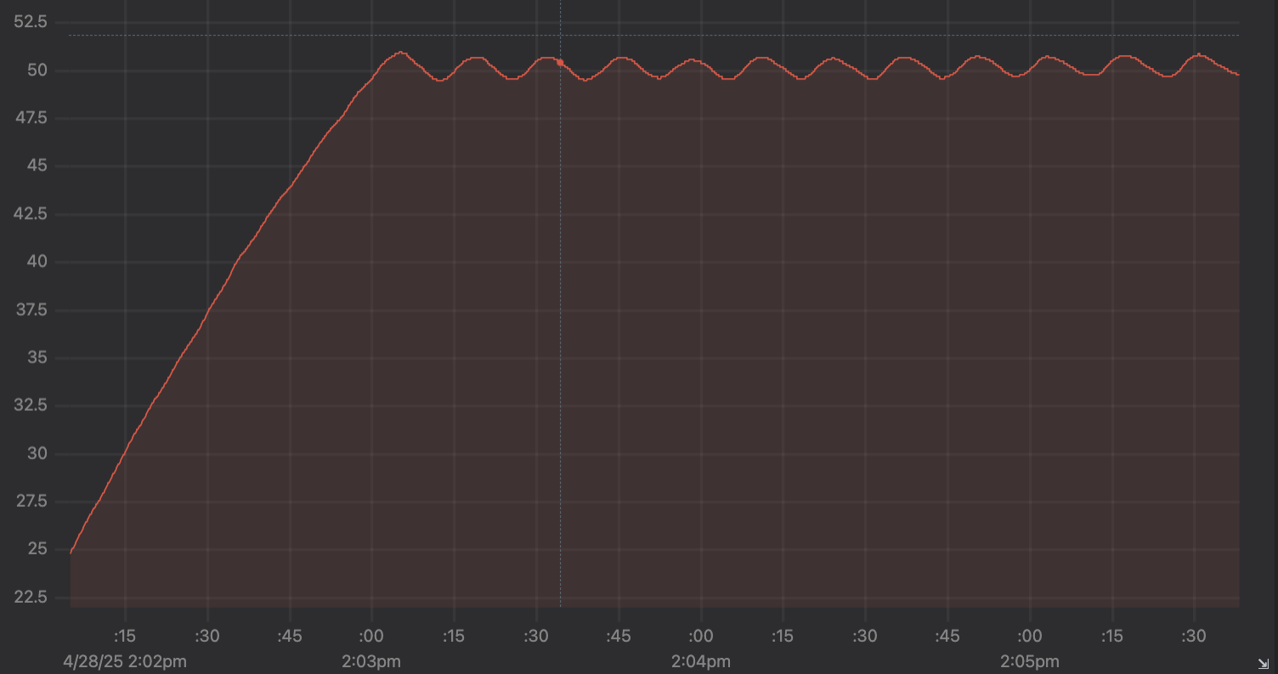
Heating Feedback Control Implementation
Temperature Monitoring:
Measures resistance via a voltage divider circuit
Resistance is converted to temperature using the Beta equation
Control Logic:
The controller uses bang-bang feedback control to maintain a user-defined temperature within ±2°C
Five minutes of temperature data as the heating pad warms from room temperature to 50 °C.
Notes:
Now that the all sample manipulation systems have been covered, I will hand it over to Cole to go over how the user could extract samples durning one of these cycles.

Slide 17
Movement Subsystem Design
Movement system objective:
Allow researchers to take samples from vials mid-cycle
Design approach:
Needed to support the heating pad and vials above mixing location
The subsystem should maintain a rigid support for the overall frame
Use strong materials commonly found in 3D printing and CNC applications
Notes:
The purpose of the extraction system is to allow researchers to take samples mid cycle - without needing to reach inside the box
This helps them steer clear of the internal hardware - and enables them to focus on their biological research
Furthermore, the extraction system supports the heating pad and helps maintain rigidity in the overall box frame.
Structural integrity of the movement system was a very important

Slide 18
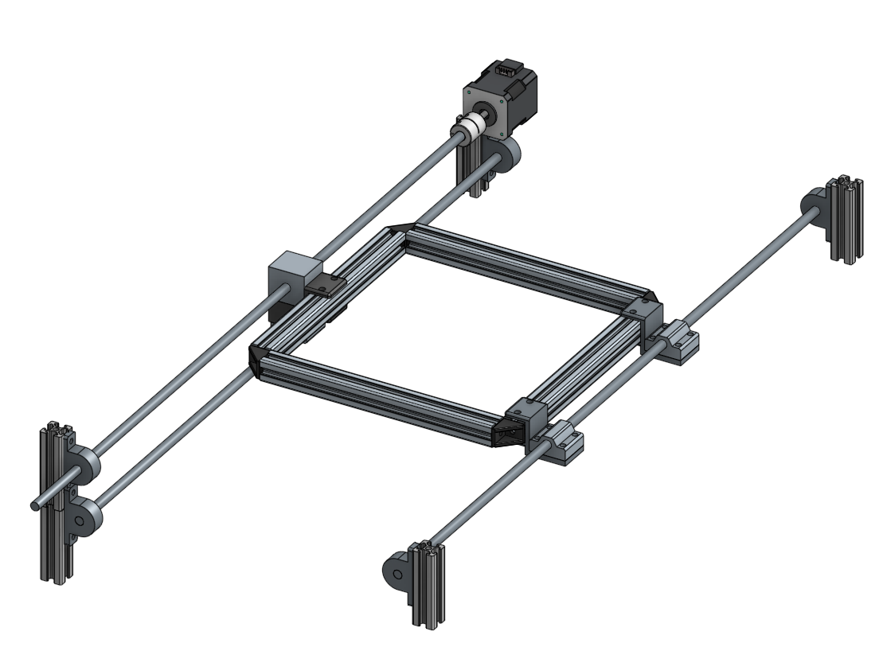
Movement System Design - V5.1
Motor for linear rotation
Experimental Zone
Heating pad and vial placement
Plate Movement
Rail system mounted to box frame
Dual Support
Extraction Zone
Figure 4: Updated CAD model (Link)

Slide 19
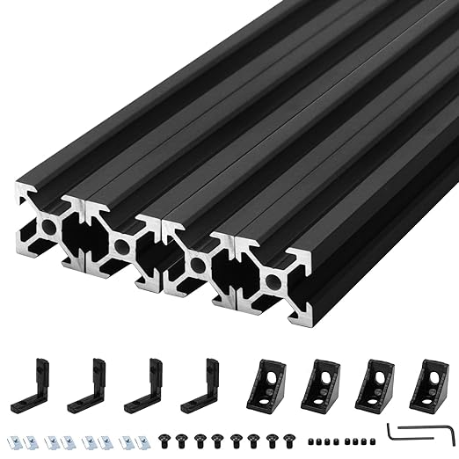
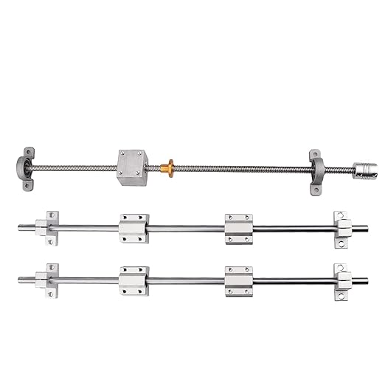
Movement System - Common Industry Materials
Lead screw and smooth pole rails
2020 V-slot aluminum extrusion rails

Slide 20
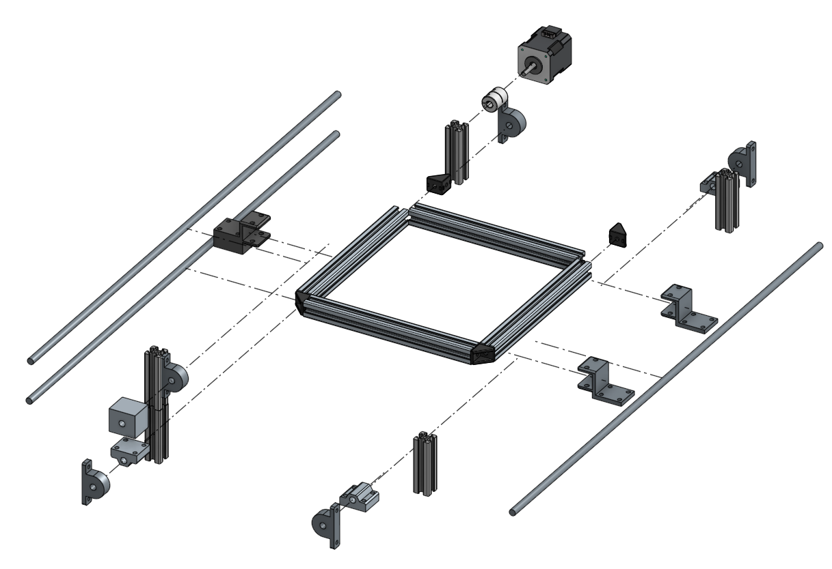
Movement System - Exploded View
Materials Used
Steel
Thermal resistant resin 3d printed (SLA)
Aluminum (everything else)

Slide 21
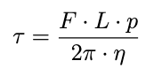
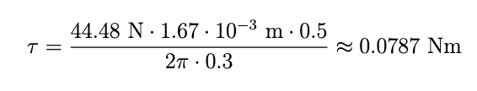
Movement System - Power Requirements
Parameter | Value
Lead screw length | 600 mm
Lead screw diameter | 8 mm
Pitch | 6 threads/cm (i.e., 1.67 mm per revolution)
Coefficient of friction (steel on brass) | 0.19
Efficiency (η) | 0.30 (estimated)
Rolling friction factor | 0.5
The total downward force from the platform, brackets, and heat plate was calculated as:
Assuming horizontal motion and taking into account rolling friction and lead screw efficiency, the torque required to move this load was given by:
where: F = 44.48 N (force), L = 1.67 mm (lead/pitch per revolution), η = 0.30 (lead screw efficiency), and p (rolling friction multiplier) = 0.5
(All friction values were slightly overestimated as a precaution)

Slide 22
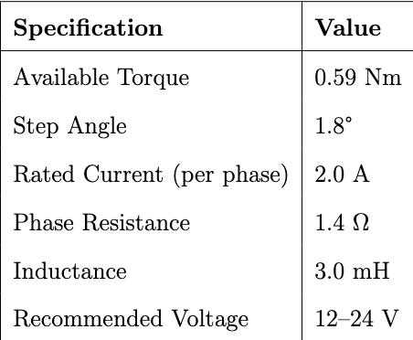
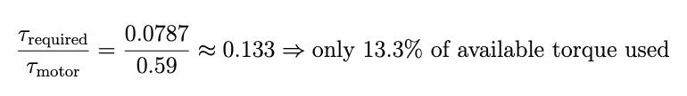
Movement System - Motor Selection
From these torque calculations, we chose the Nema-17 stepper motor, a widely used option in motion control applications such as 3D printers and CNC machines

Slide 23
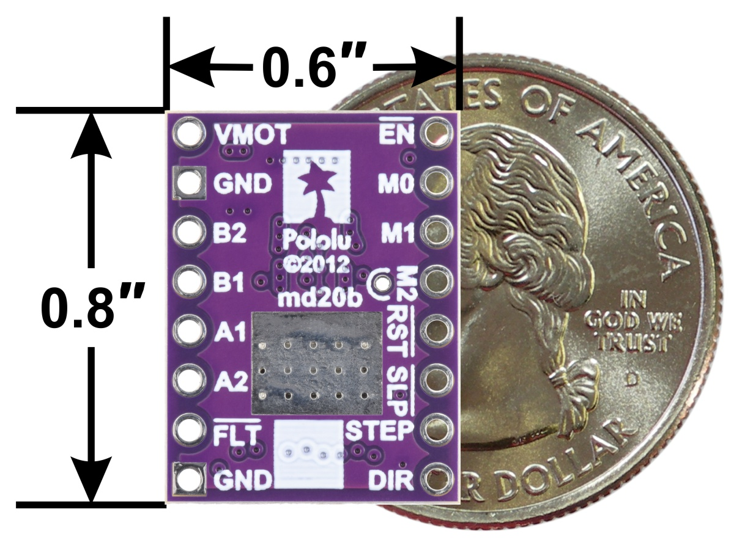
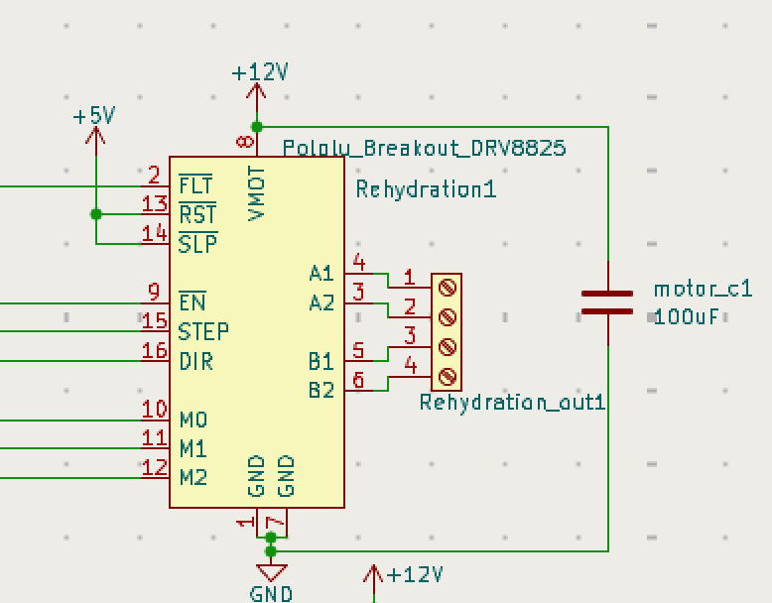
Stepper Motor Driver Implementation
Motor Driver Selected:
Pololu DRV8825 Breakout Board (circuit)
User Control
A modular library is used to initialize and abstract control for motors in both subsystems
Reason for Selection:
Precise microstepping control
Adjustable current limiting
Built-in fault protection
Notes:
Now that we have gone over all the subsystems Cole will show you how the user interacts with the device.

Slide 24
User Interface Design
User interface objective:
UI needed to give researchers control of each experiment without physically touching the box.
Design approach:
We needed a computer based webpage
Ability to store data between experiments or in the event of power loss

Slide 25
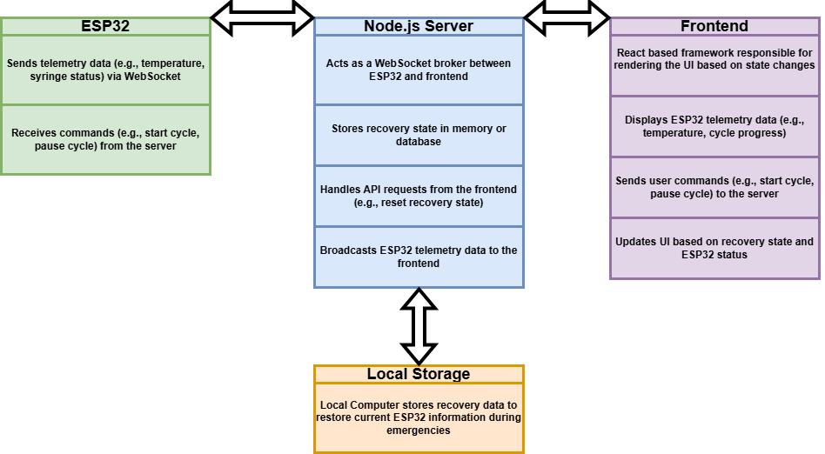
User Interface Design - Tools Used

Slide 26
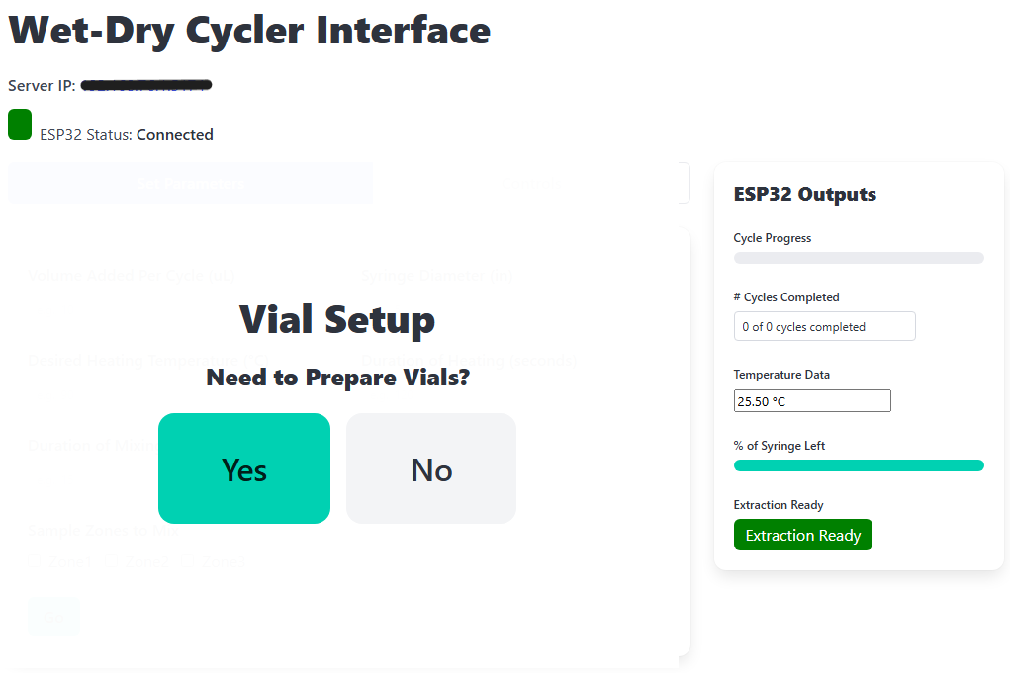
User Interface - Initial Page

Slide 27
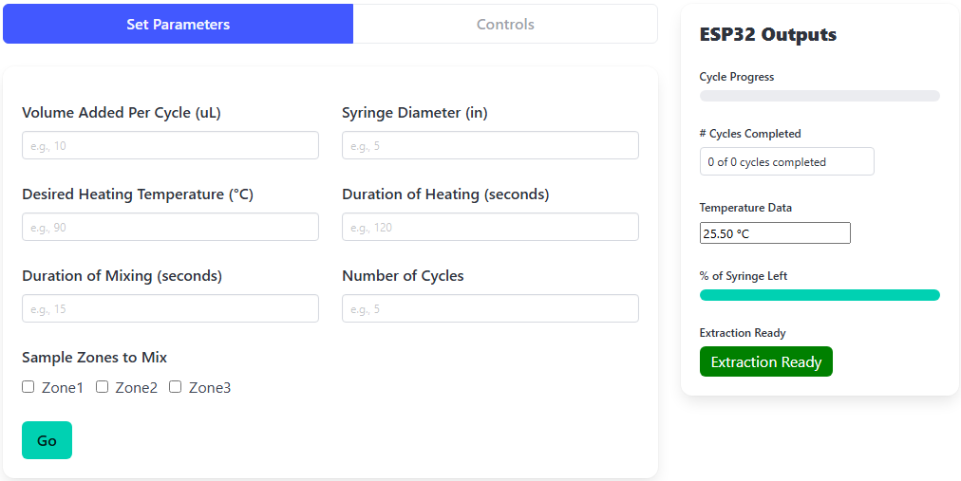
User Interface - Parameters Setup Page

Slide 28
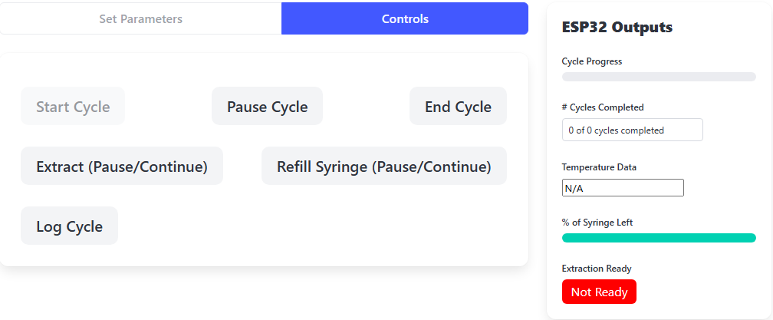
User Interface - Initial Page

Slide 29

Embedded System Design
Embedded System Objectives:
Create ESP32 firmware handle to handle subsystem control while maintaining continuous communication with the front-end via WebSockets
These are the sensor input signals to the ESP32
These are the motor and temperature control output pins from the ESP32
This is the output and input of the ESP32 to the front-end website

Slide 30
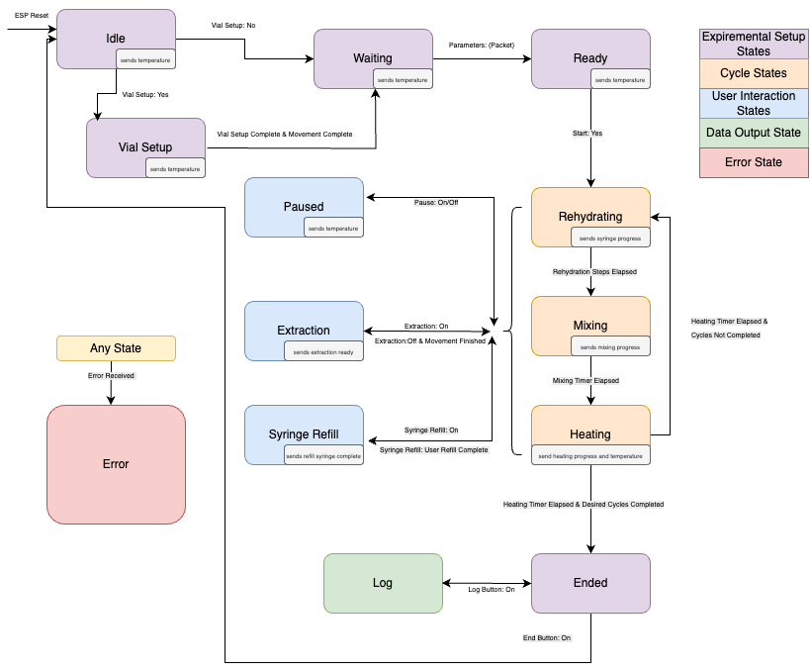
Embedded State Machine
Link to state machine
Notes:
Description of the system using laser pointer.
Implements a real-time state machine on the ESP32 to manage experimental flow.
Handles transitions between user interaction, cycle control, and error recovery states.
Modular libraries were developed for each subsystem (Heating, Mixing, Movement, Rehydration) for clean integration and scalability
To power the entire system and facilitate all the hardware executed in this code, Matthew will introduce the power system.

Slide 31
Power Subsystem Design
Power subsystem objectives:
Ensure stable voltage regulation for each component
Provide sufficient current to meet the demands of each load
Design approach:
Developed a power budget to define load requirements
Created a power system block diagram to outline architecture
Produced an engineering schematic for validation and testing

Slide 32
Engineering Standards Used for Power System Design
Standards Followed:
Technical Documentation Standards in Engineering Design — UCSC ECE Department (Petersen & Favaloro)
Introduction to Power Supplies (AN-556) — Ralph E. Locher, National Semiconductor
NEC Ampacity Guidelines — Published by USA Wire & Cable, based on the National Electrical Code (NEC)

Slide 33
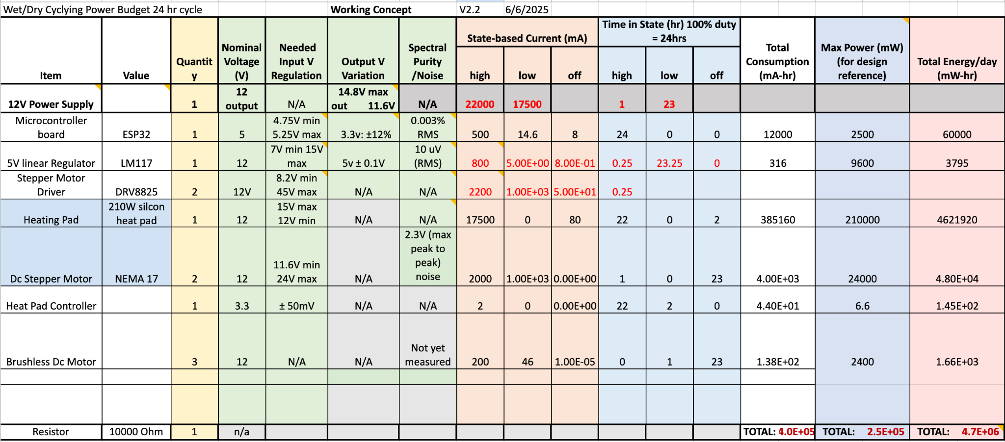
Power Budget Used to Define Load Requirements

Slide 34
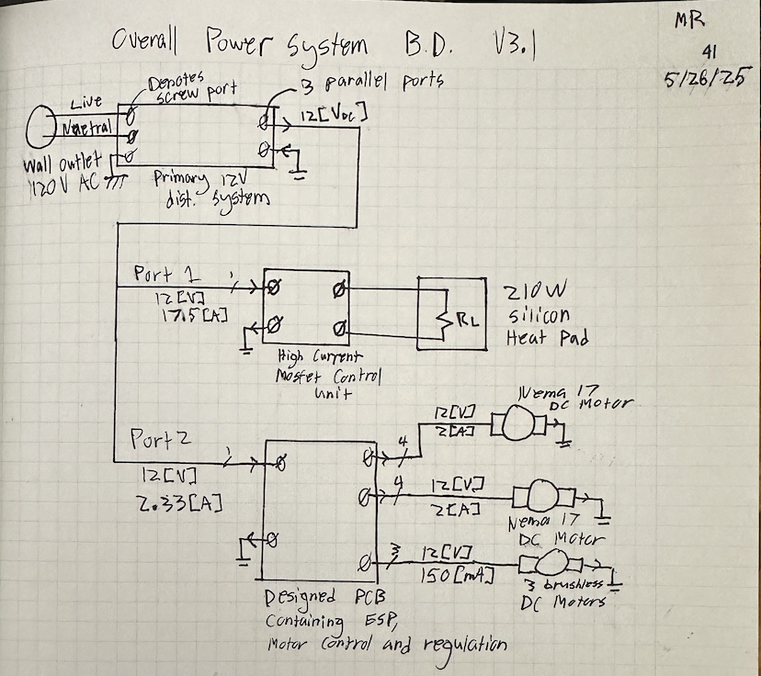
Overall Power System Block Diagram
Power Block Diagram Overview
Shows top-down 12V DC power distribution from wall-powered supply
Port 1 powers a 210W heat pad
Port 2 supplies the custom PCB and all motors
Diagram includes labeled voltage/current values and grouped functional blocks for clarity and traceability

Slide 35
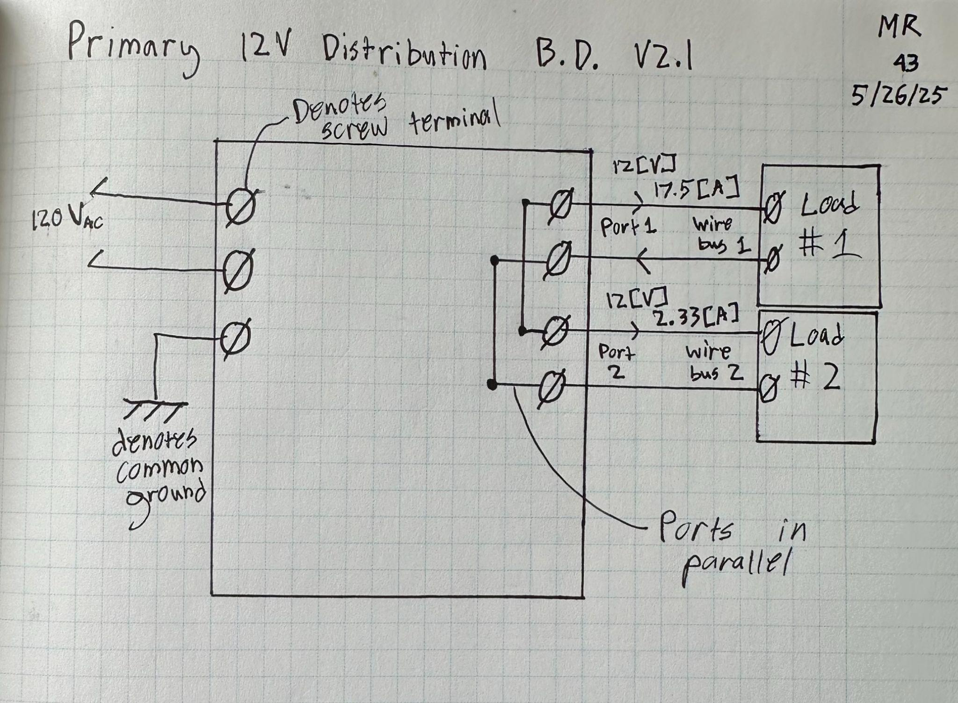
Decomposed Power System Block Diagram
Wire gauge selection is critical when there is significant voltage drop or heat rise in the wire
Each wire bus was sized based on current draw, length, and allowable voltage drop
Proper return paths were defined to reduce noise and avoid ground offsets between loads
Load 1 required 12 AWG wiring, while load 2 used 18 AWG

Slide 36
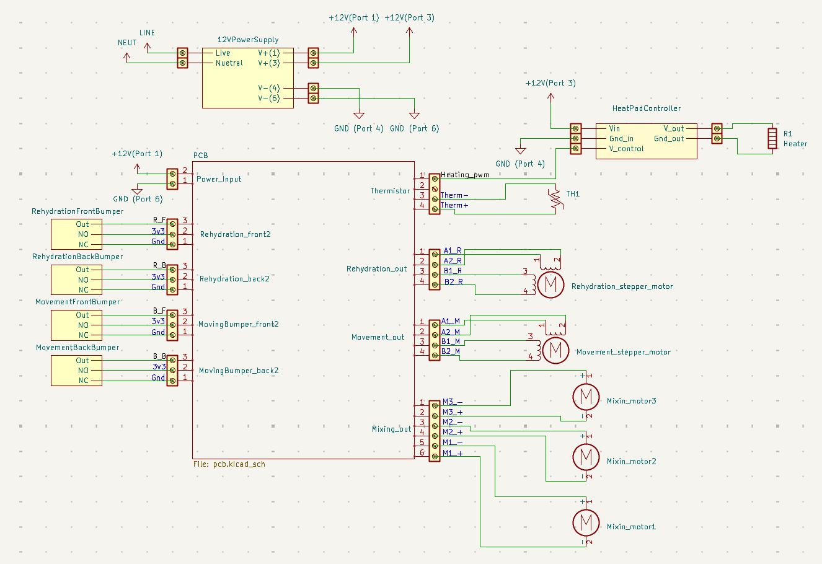
Power System Engineering Schematic

Slide 37
Printed Circuit Board Design
Design Motivation:
Simplify the electrical system by integrating key components on one board
Design Goals:
Route all necessary microcontroller signals
Enable controlled power delivery from the external power supply
Workflow:
Designed a schematic capturing all components and connections
Translated the schematic into a physical board layout with component placement and trace routing

Slide 38
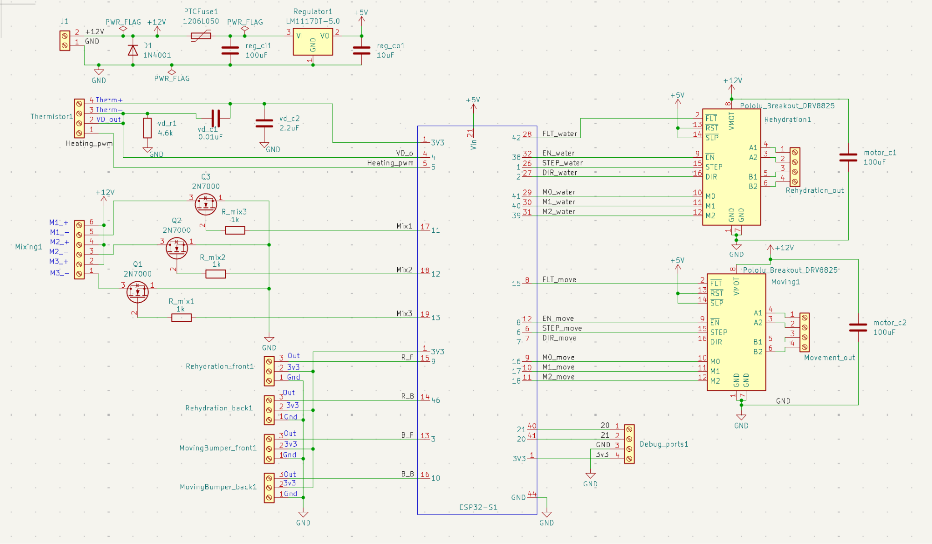
Engineering Schematic for Designed PCB

Slide 39
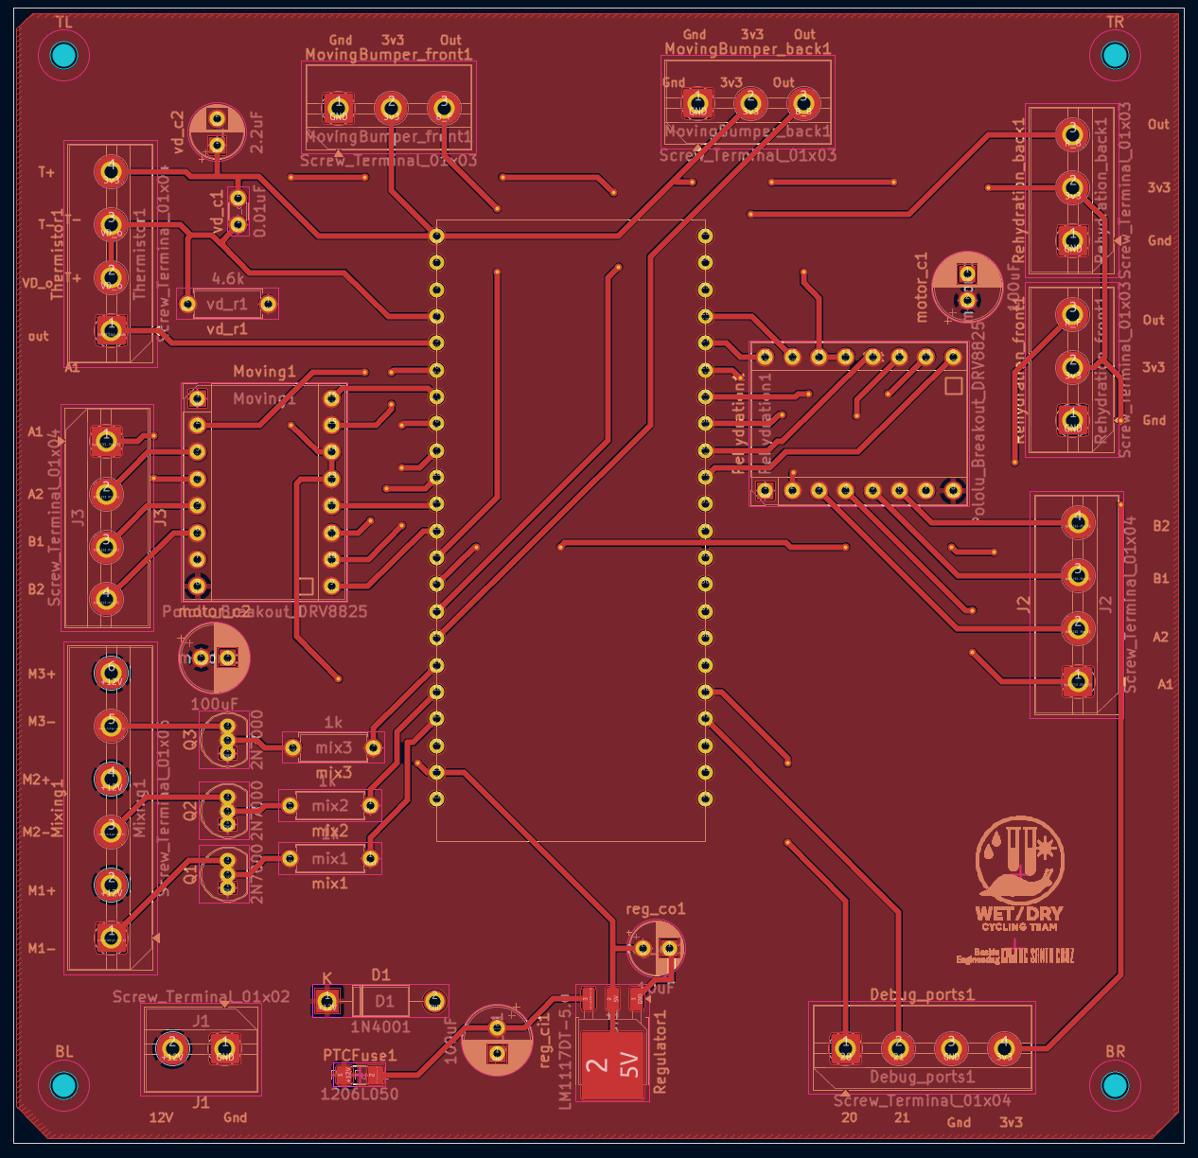
Layout and Routing of Designed PCB: Top Layer
Top Layer PCB Design Highlights
Top layer used for routing signal traces (20 mils) and distributing power through a 12V copper pour
Components were placed based on physical positions in the system, not traditional signal flow
Placement simplified wiring and reduced off-board connector complexity
High-power components were positioned to allow short, efficient power paths
Notes:
Signal and low-current traces were routed at 20 mils—the widest possible width that allowed efficient board routing—verified against IPC-2221 guidelines to safely support expected currents, with each connected subsystem mounted at a designated mechanical location.

Slide 40
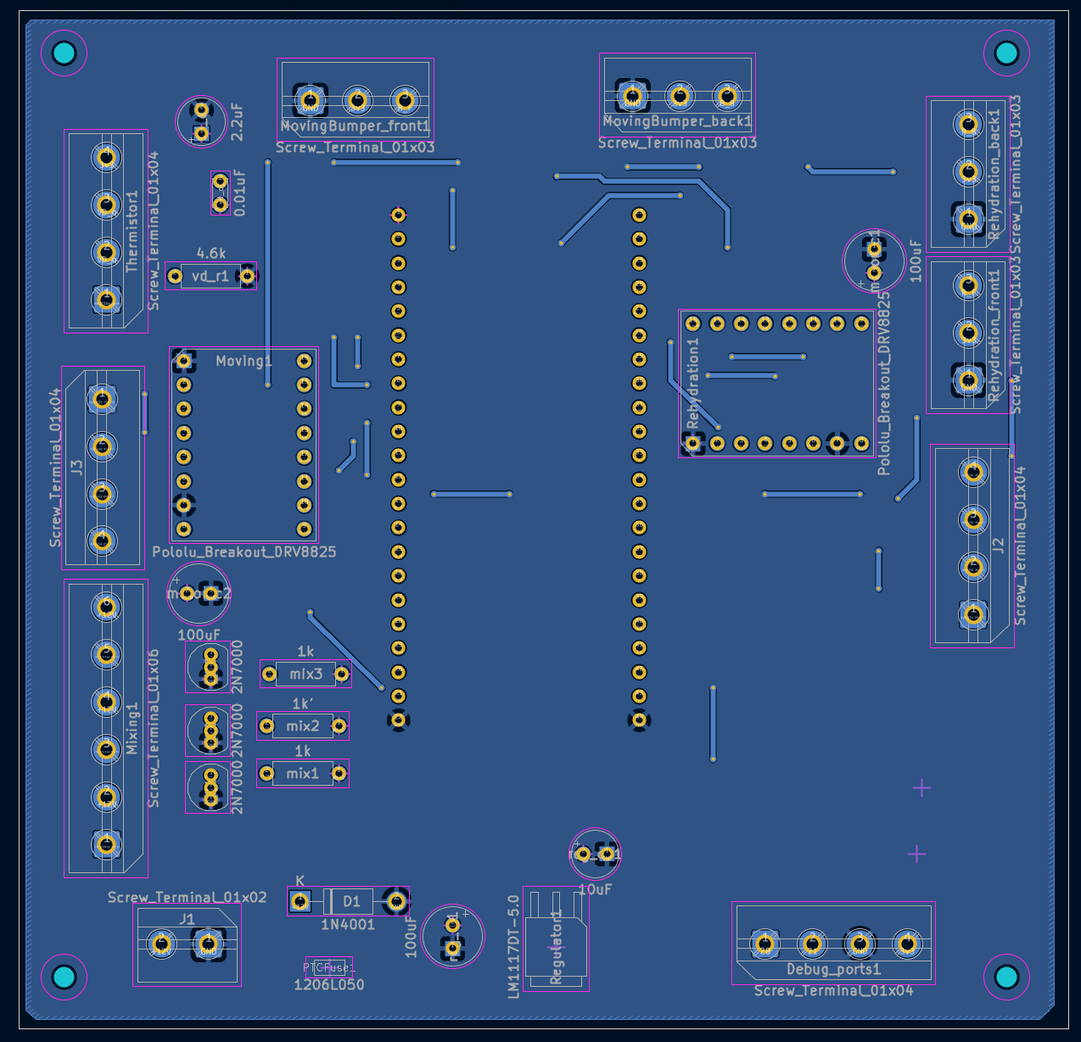
Layout and Routing of Designed PCB: Bottom Layer
Bottom Layer PCB Design Highlights
Bottom layer implemented as a continuous ground plane
Ground plane provides a low-impedance return path for signal and power currents
Maintains stable reference potentials
Used for via stitching to connect top-layer traces while preserving proper return current flow

Slide 41
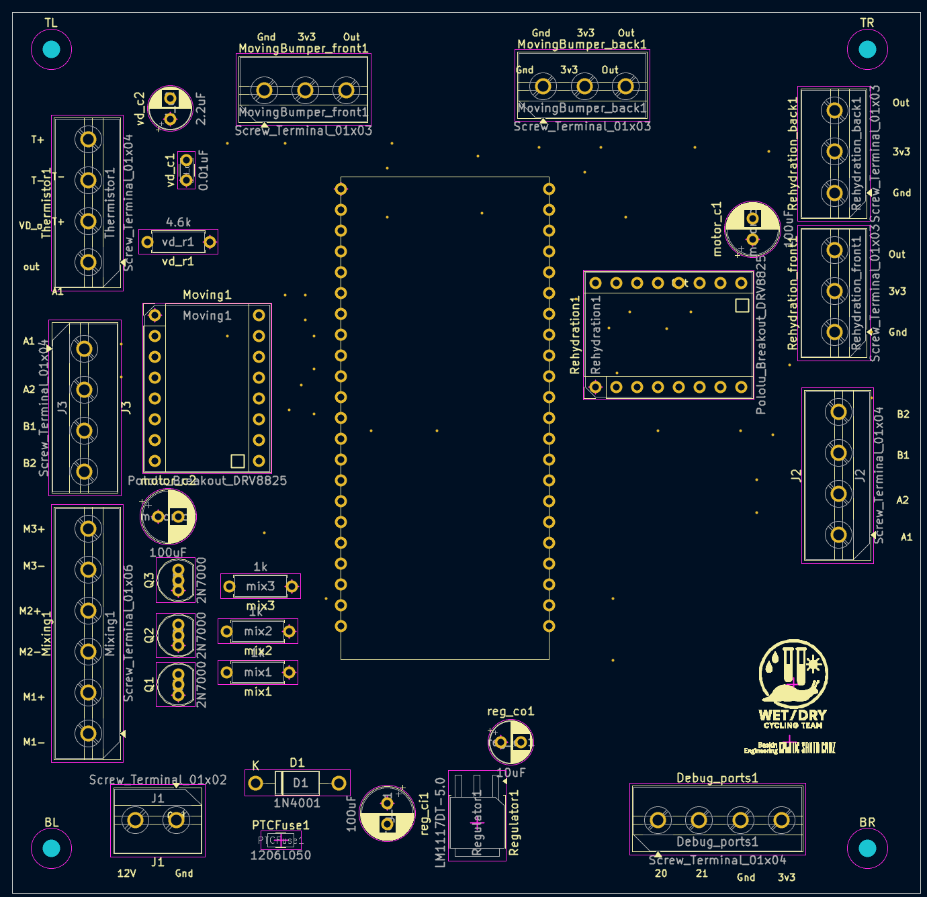
Layout and Routing of Designed PCB: Silkscreen
Silkscreen Layer PCB Design Highlights
Aids in soldering and wiring external components during assembly
Polarized components include orientation markings for correct placement
Screw terminals and input pins are clearly labeled
Motor controller footprints include square indicators for potentiometer tuning

Slide 42
System Housing Design
Design Motivation:
Design structural housing that encloses the physical zones and provides mounting for other submodules
Design Goals:
Needs to be as sterile as possible and needs to be enclosed from the outside environment
Mounting methods needs to be secure for prolonged use in possible high temperature environments
Simple and easily repairable design, so a non-engineer research technician can diagnose and fix any issues

Slide 43
Design Approach
No - Redesign
Brainstorm Idea in Notebook
Address with Team if design can be integrated
CAD Model
Redesign
Yes
Laser Cut Part
Large Framing Parts
Update Overall System CAD Design
Fabrication
Verification of System
3D print Part
Small Specialized Parts

Slide 44
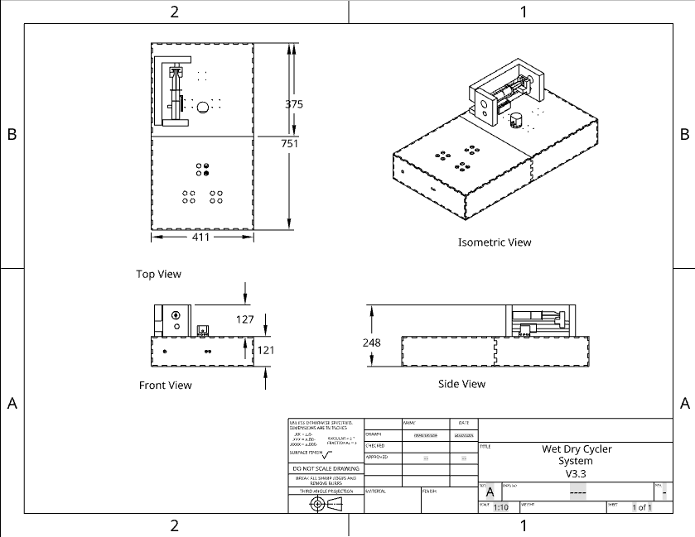
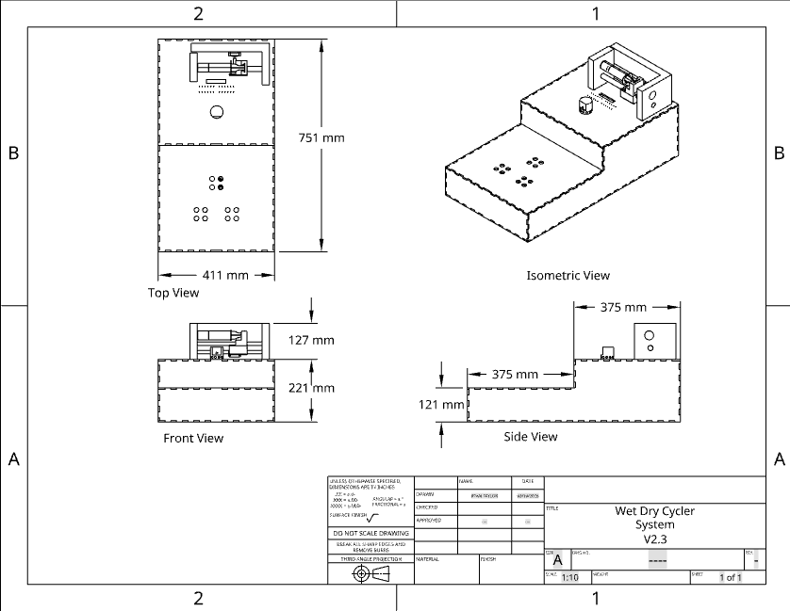
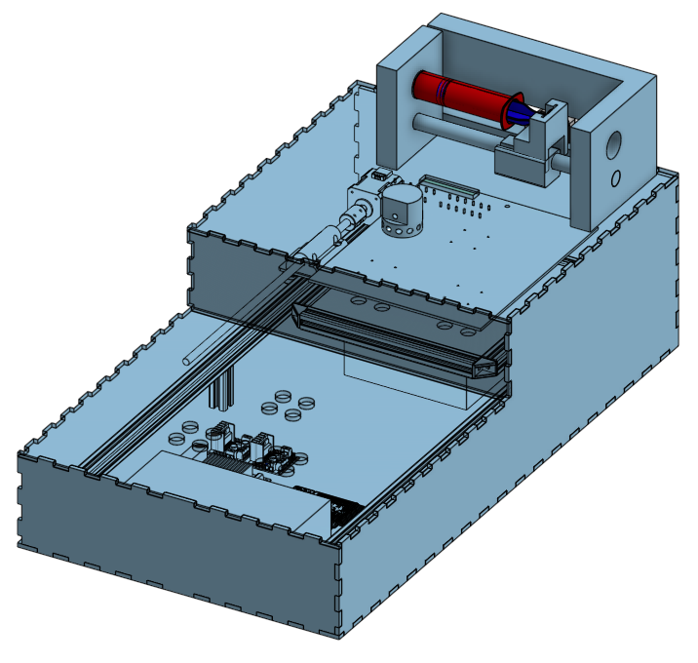
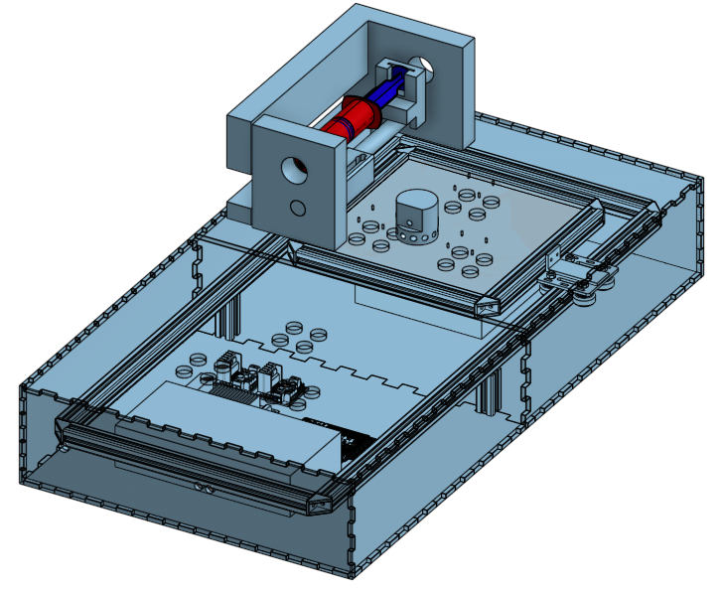
Design Evolution and insights learned
Figure 3: Four View Drawing of V3.4
Size reduction
Figure 1: Four View Drawing of V2.3
Step for syringe
Single Rectangle for framing
Single side rails
Tab-and n-slot framing
Figure 2: Image of CAD model of V2.3
Figure 4: Image of CAD model V3.4

Slide 45
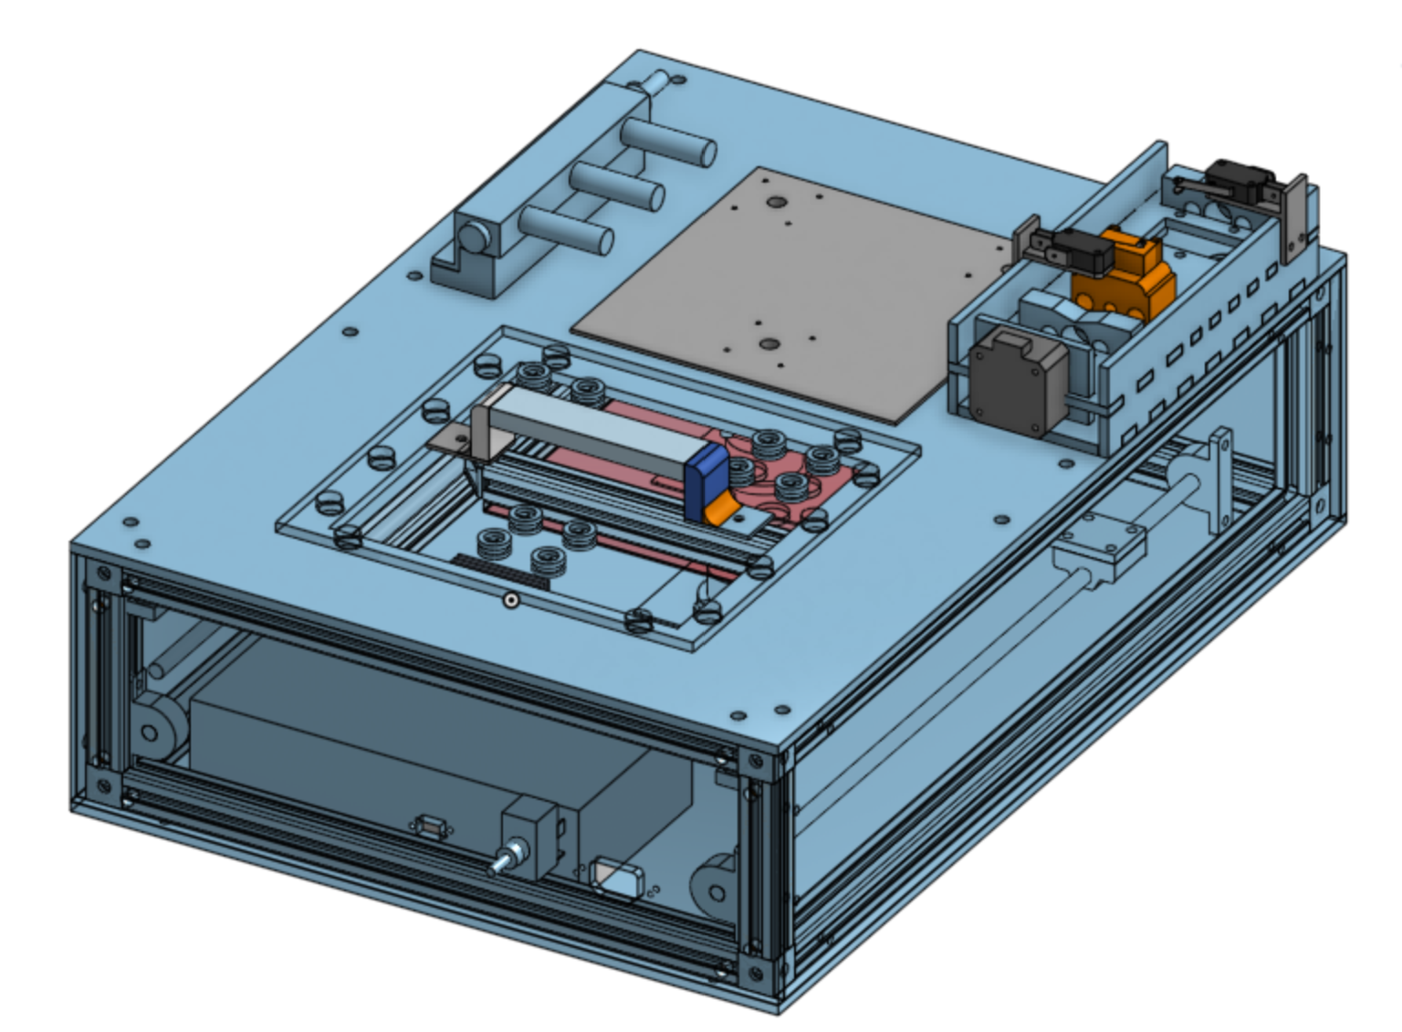
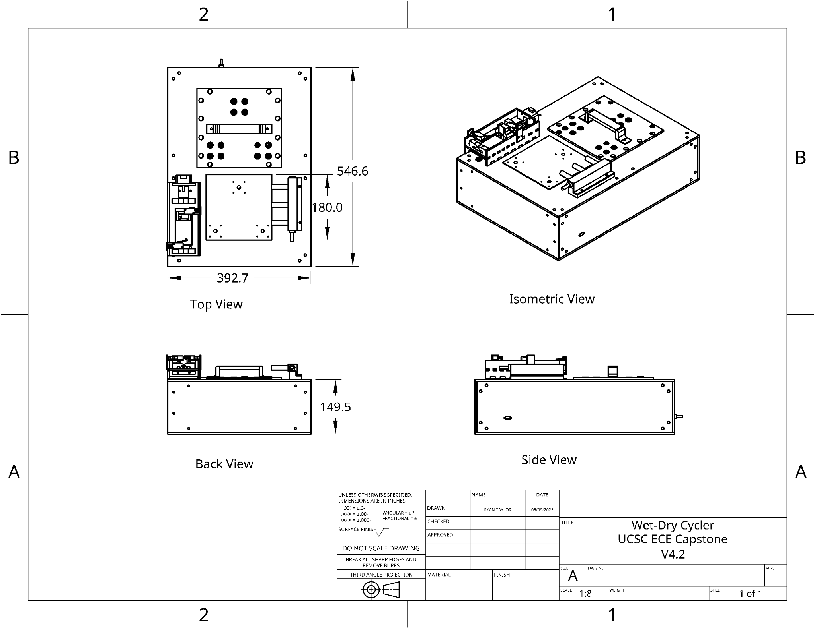
Final Mechanical Design
200 mm Smaller
Screw’d on Framing
Rectangular Cube Framing
Figure 1: Four View Drawing of Prototype Exterior
Figure 2: Image of CAD model
CAD

Slide 46
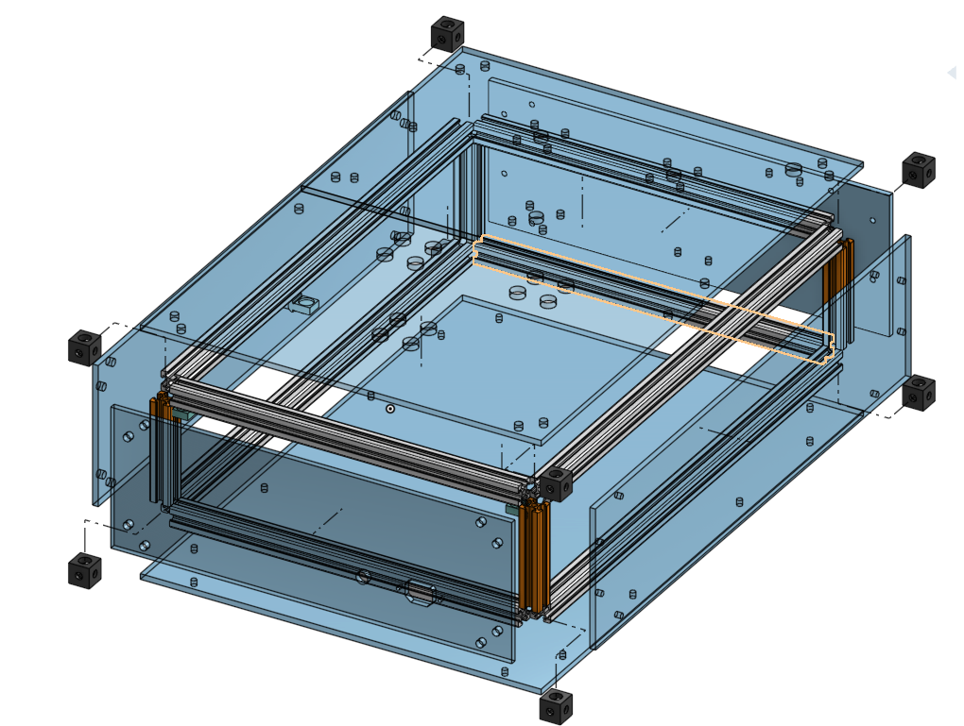
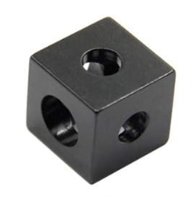
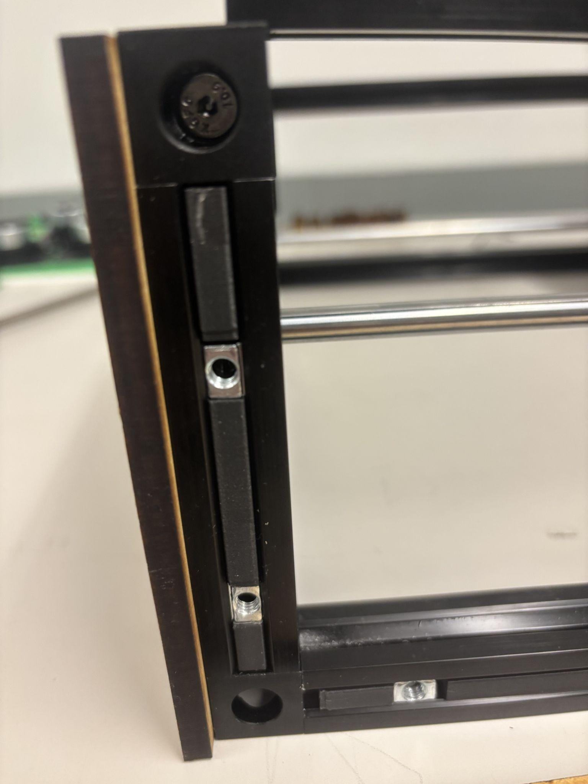
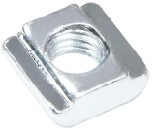
Aluminum Framing for system Integration
2020 Aluminum V-slotted Rails for System Framing.
This material allows for rigid structure with modification ability due to the V-slot Rails
2020 V-slot Sliding nuts to fasten acrylic to the aluminum frame
-Utilizing Frame Buffers to keep nuts in place
Cube Connectors to attach corners at 90 degree angles

Slide 47





Mounting System
Mixing Motors Mounted to Base Plate
Power Supply and PCB Mounted to Base Plate
Rehydration System Mounted to Top Acrylic Sheet
3D printed Stepper motor mount onto the 202 V-slot
Printed using PETG for thermal considerations

Slide 48



Extraction System
Extraction System uses
Straw Hole Plug’s to keep the system environment contained internally.
The Sample can then be extracted using a pipette through the straw hole
This system also works as a pot lid that can be taken off to reset the vials
The “pot lid” is held down by 12mm X 2mm neodymium magnets that create a firm seal to the top acrylic sheet

Slide 49

Overall System Overview

Slide 50
Conclusion
Guided by initial project deliverables and engineering standards; system performs as intended and will be handed off for continued PhD research
The wet/dry cycling system reduces cost and increases throughput for RNA synthesis experimentation, supporting origin-of-life research
RNA's role extends beyond origins of life research to therapeutic applications like CRISPR and RNA Vaccines (Covid-19 Vaccine)
With current costs for therapeutic RNA at $120,000 per human dosage, this research seeks a low-cost therapeutic RNA synthesis method using only water, heat, and precursor chemicals.

Slide 51

Thank You

